Slide 1
GenAI with MLflow
Michael Berk, RSA @ Databricks

Slide 2



Questions
MLflow
Talk Code

Slide 3
1/3 - What is MLflow?

Slide 4

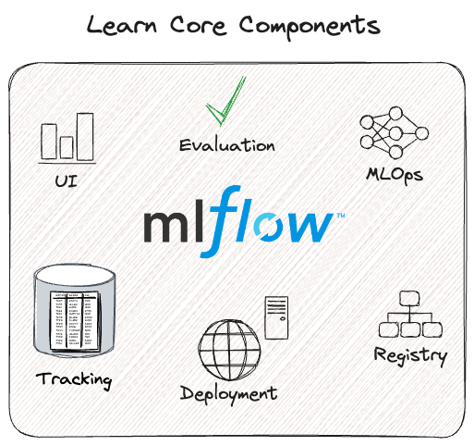

Slide 5
Object store to hold
information about your
runs

Slide 6
SQL database to support model versioning

Slide 7
Automatic metadata logging to the tracking server to facilitate serving

Slide 8
A user interface!

Slide 9
A high-level API and UI to evaluate your models

Slide 10
A proscriptive development strategy for building and deploying AI

Slide 11
Benefits
Managed model lifecycle
Easy deployment
Robust additional utilities

Slide 12
2/3 - What are useful GenAI features?

Slide 13
Standard MLflow dev cycle
Tracing
Evaluate
Prompt Registry

Slide 14
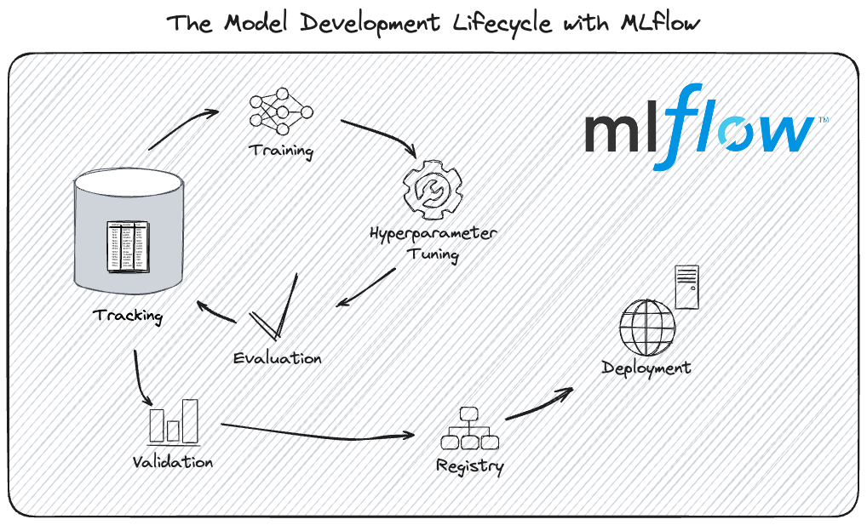
MLflow Dev Cycle

Slide 15
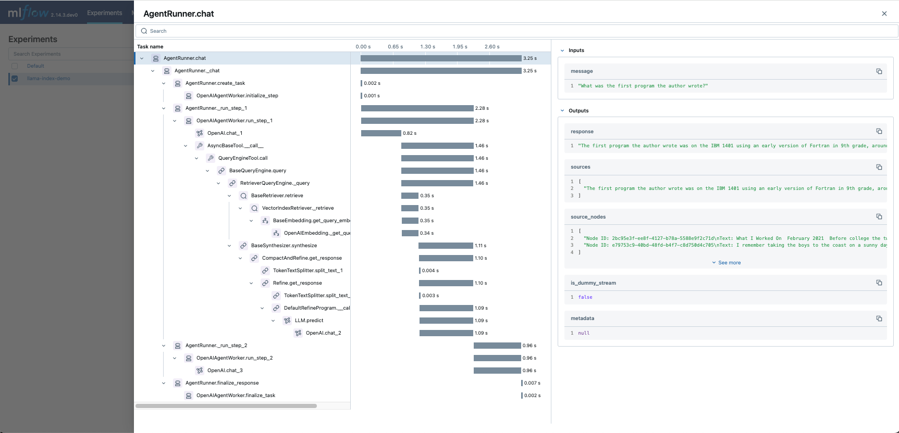
Tracing

Slide 16
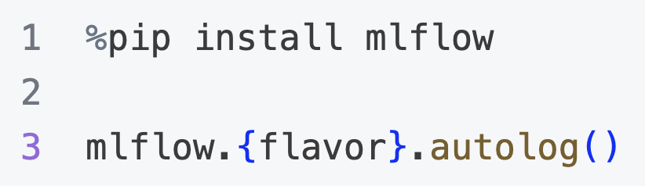
Tracing

Slide 17
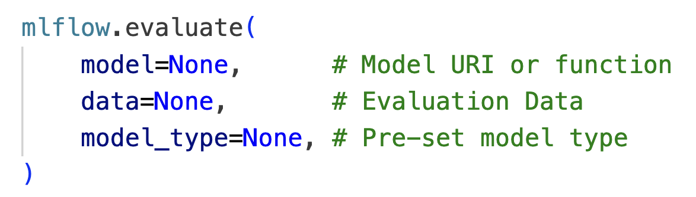
Evaluation

Slide 18
Prompt Registry
Let’s check the docs!

Slide 19
3/3 - Let’s code!

Slide 20
Questions?
Questions
MLflow
Talk Code

